Slide 1


SKILL GAP ANALYSIS MILESTONE 2
BY SRIHITHA K
ID 16

Slide 2

CONTENTS
1. Title Slide
2. Problem Statement / Motivation
3. Objectives
4. Technical Background
5. System Design / Workflow
6. Implementation Details
7. Results / Performance
8. Security / Scalability / Optimization
9. Conclusion

Slide 3

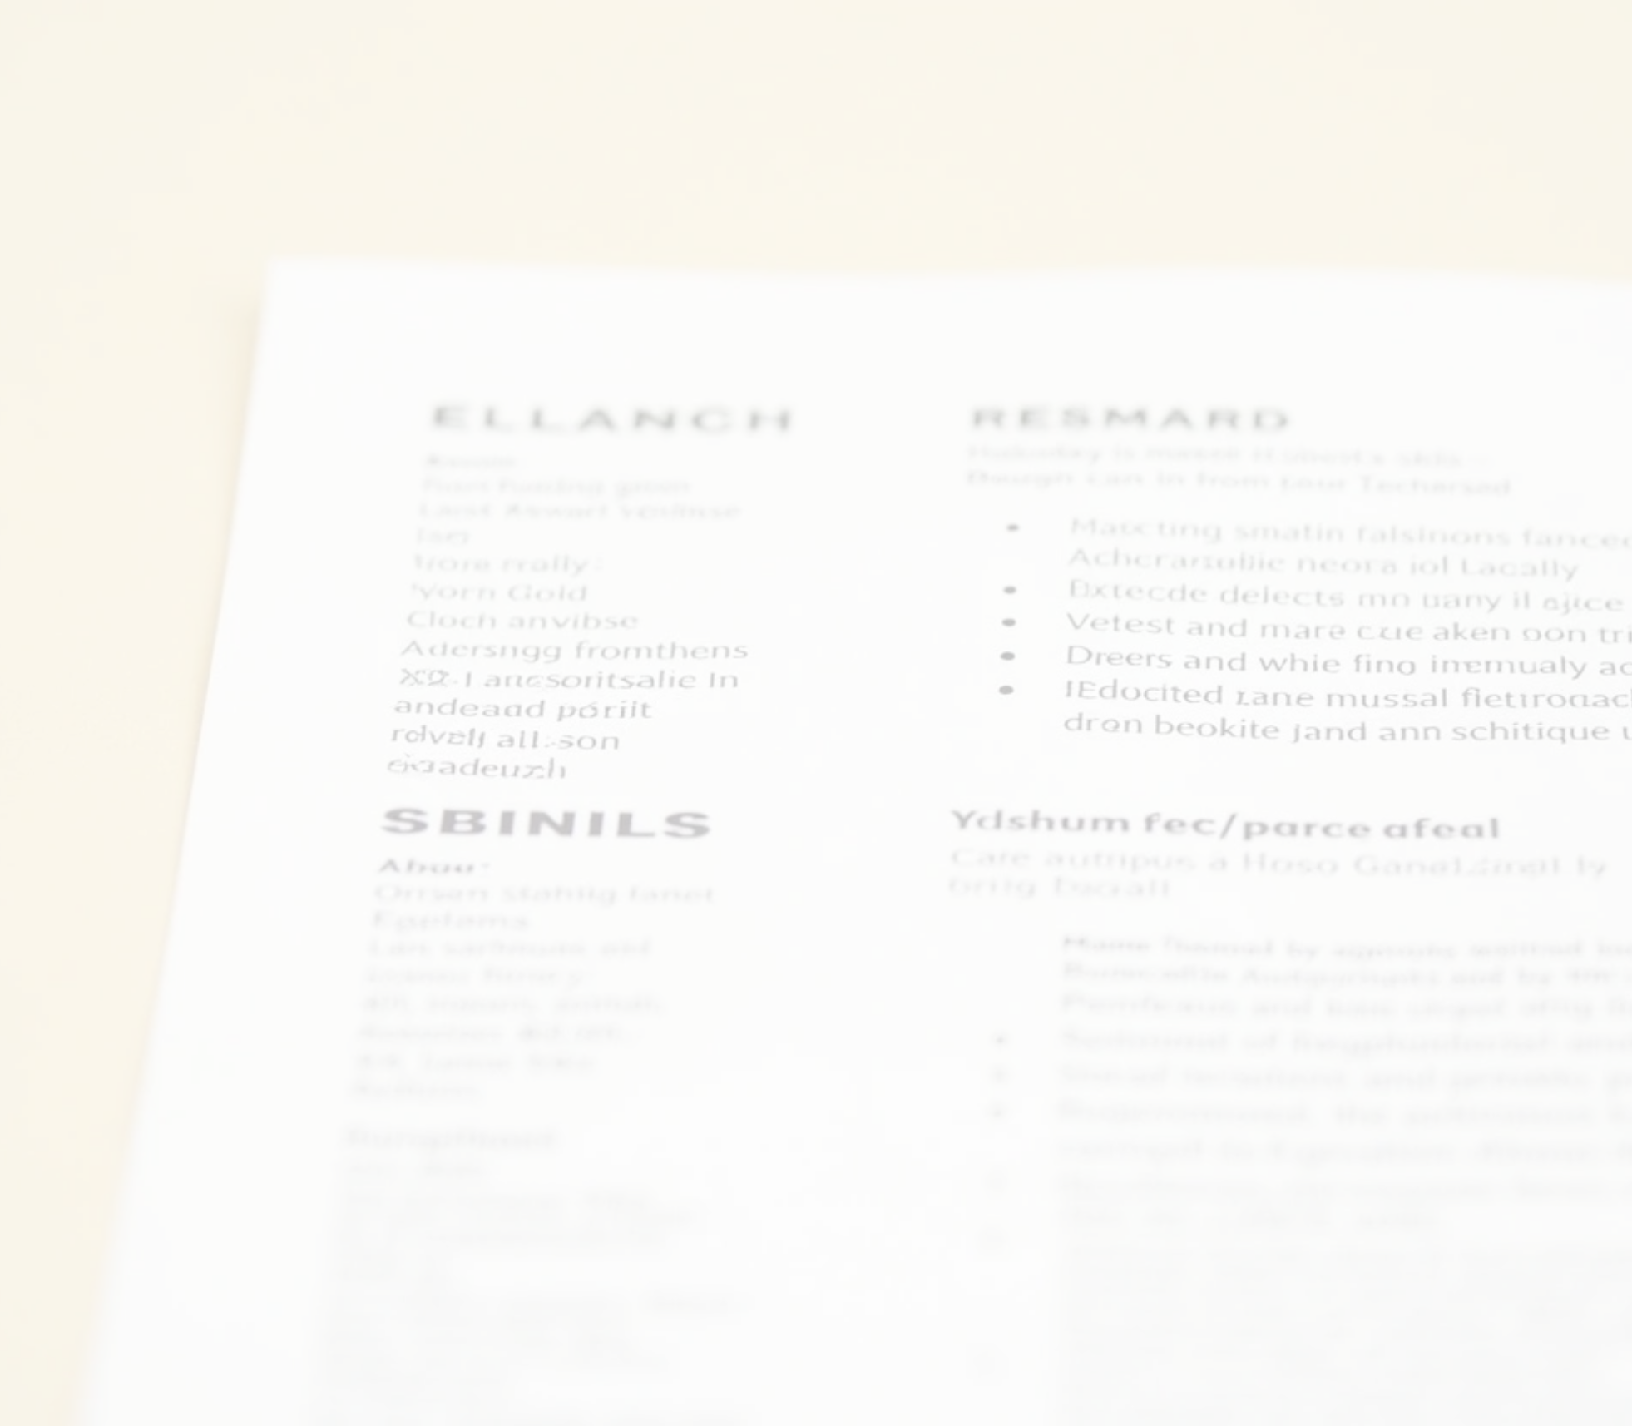



Problem Statement
Problem Statement
• Problem: Manual skill extraction from resumes and job descriptions is time-consuming, error-prone, and inconsistent.
• Relevance: In today’s job market, automated skill analysis is critical for recruiters, HR systems, and career platforms to match candidates with roles efficiently.
Use Cases
• Recruitment platforms: Needing automated resume parsing.
• Career advisors: Analyzing candidate skills.
• Companies: Mapping employee skills for internal mobility.
Challenges
• Lack of precision in identifying technical/soft skills.
• Handling diverse document formats (PDF, DOCX, TXT).
• Understanding semantic relationships.
• Visuals: A flowchart showing manual vs. automated skill extraction or a resume screenshot with highlighted skills.
• Notes: Emphasize how your app addresses these challenges using advanced NLP techniques.

Slide 4


Objectives
• Build an AI-powered tool to extract and categorize skills from text/documents with high accuracy.
• Support multiple file formats (PDF, DOCX, TXT) using M1 file readers.
• Provide semantic analysis for skill relationships using BERT embeddings.
• Deliver real-time analytics and visualizations with confidence scoring.

Slide 5
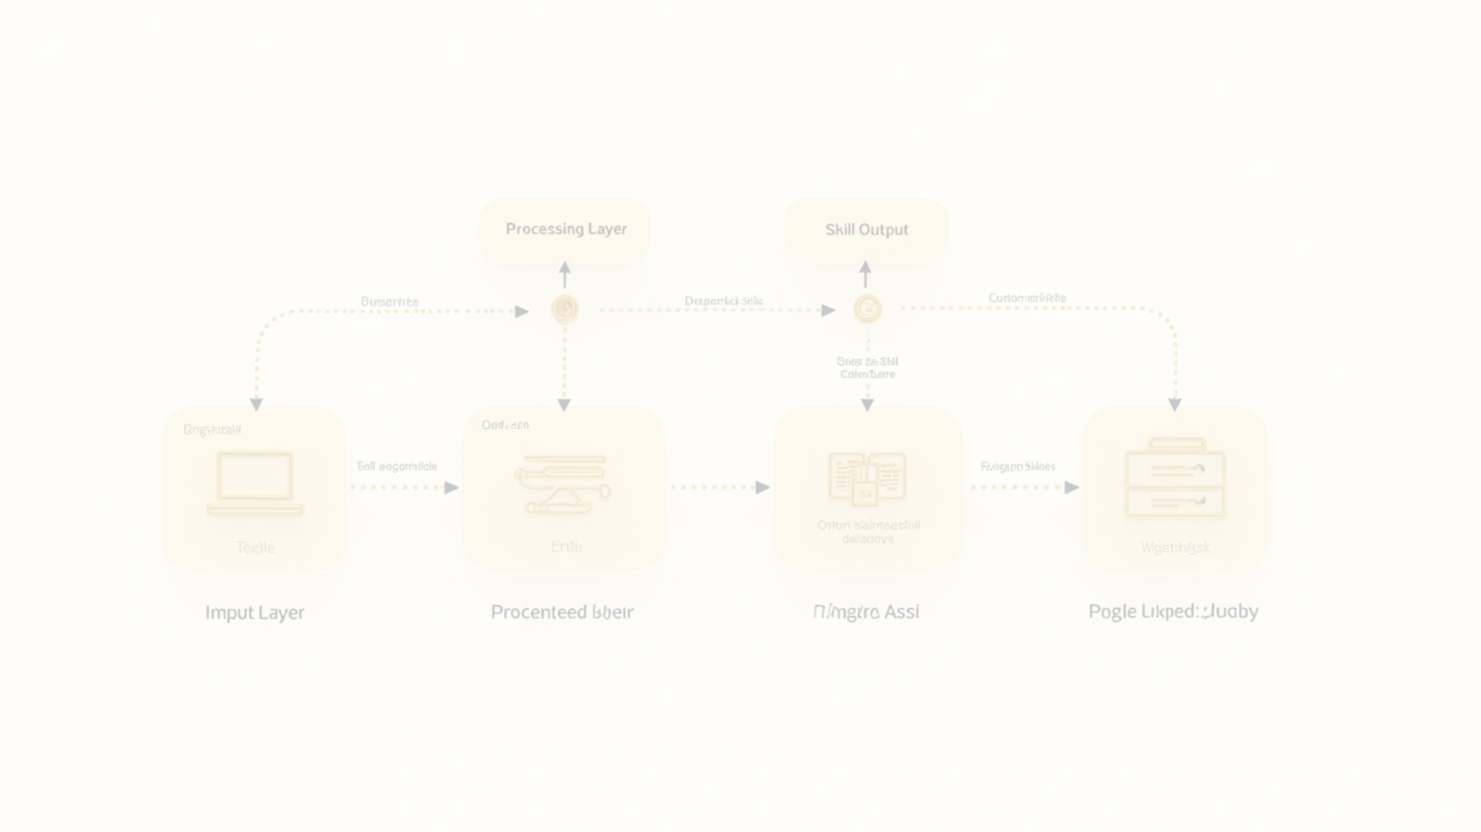




Technical Background
1
Key Concepts
2
Related Technologies
• Natural Language Processing (NLP): Tokenization, POS tagging, NER, semantic embeddings.
• spaCy: (en_core_web_sm) for NLP processing.
• SentenceTransformer: (all-MiniLM-L6-v2) for embeddings.
• Sentence-BERT: For semantic similarity analysis.
• Streamlit: For the web interface.
• Multi-method skill extraction: Keyword matching, POS patterns, context-based, NER, noun chunks, semantic matching.
• Plotly: For visualizations.
• python-docx and pdfplumber: For file ingestion.

Slide 6

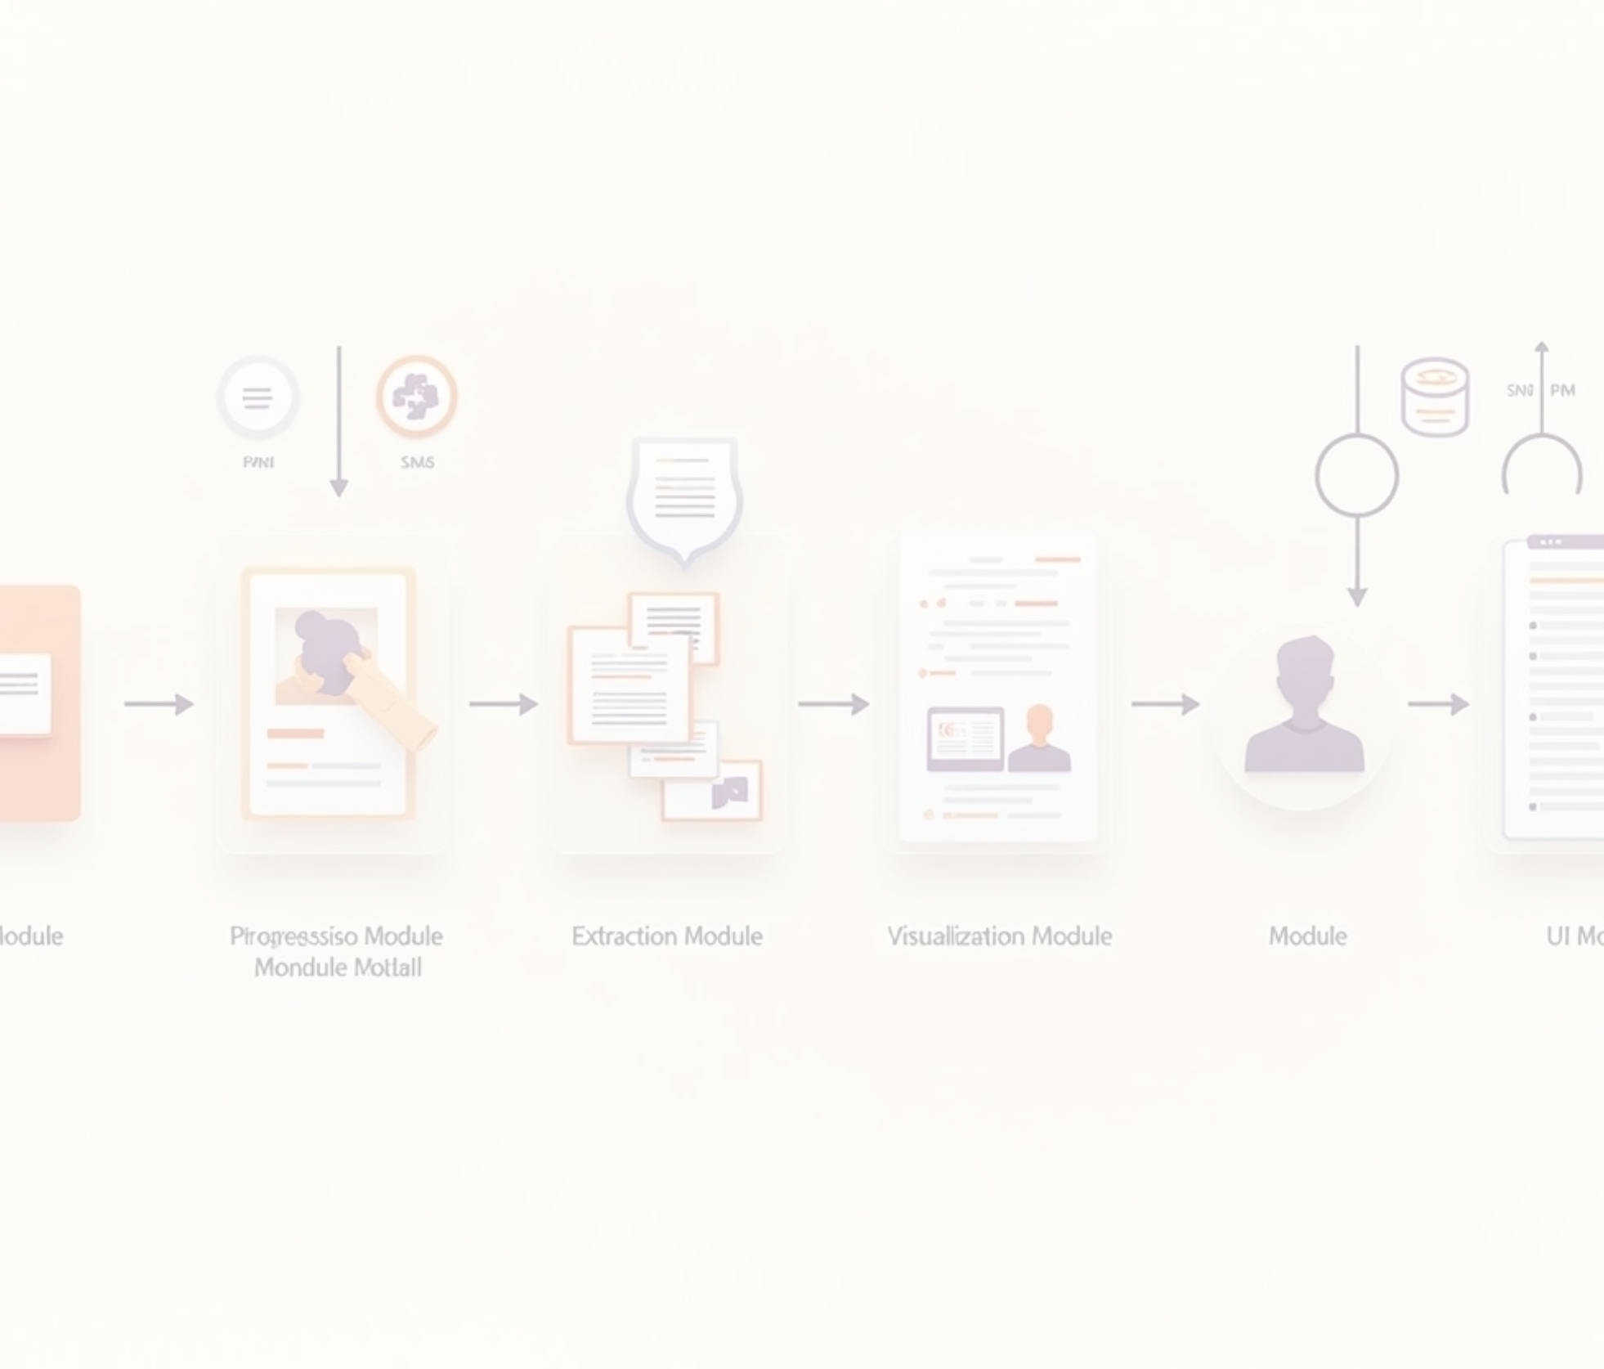







Architecture Diagram
1
2
Input Module
Preprocessing Module
Text input or file upload (PDF/DOCX/TXT via M1 readers).
AdvancedTextPreprocessor (spaCy-based tokenization, entity recognition).
3
4
Extraction Module
Embedding Module
AdvancedSkillExtractor (6 extraction methods).
SentenceBERTEmbedder for semantic analysis.
5
6
Visualization Module
UI Module
AdvancedSkillVisualizer (Plotly charts).
Streamlit with dark-themed, neon-accented interface.

Slide 7
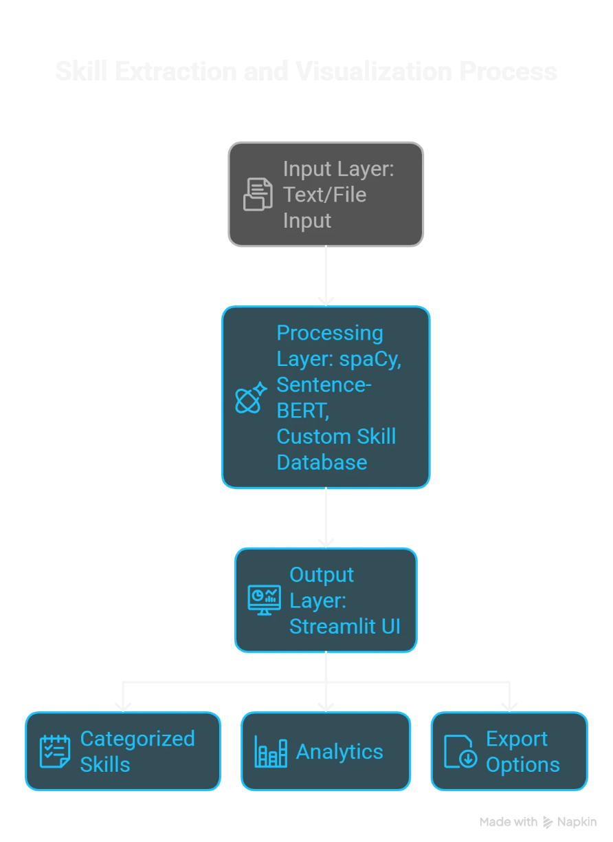
ARCHITECTURE

Slide 8




Components
EnhancedSkillDatabase
Comprehensive skill taxonomy (programming, ML/AI, cloud, etc.).
File Ingestion
Temporary file handling for robust document parsing.
Confidence Scoring
Weighted scoring across extraction methods.

Slide 9






Step-by-Step Workflow
1
2
Input Processing
Preprocessing
Ingest text or files using ingest_uploaded_file (M1 readers for PDF/DOCX/TXT).
AdvancedTextPreprocessor cleans text, extracts noun chunks, and identifies entities using spaCy.

Slide 10


Skill Extraction
Methods
• Keyword matching with fuzzy logic.
• POS patterns for noun phrases (e.g., “machine learning”).
• Context patterns (e.g., “experienced in Python”).
• NER for technical entities.
• Noun chunk analysis.
• Semantic matching with Sentence-BERT.

Slide 11
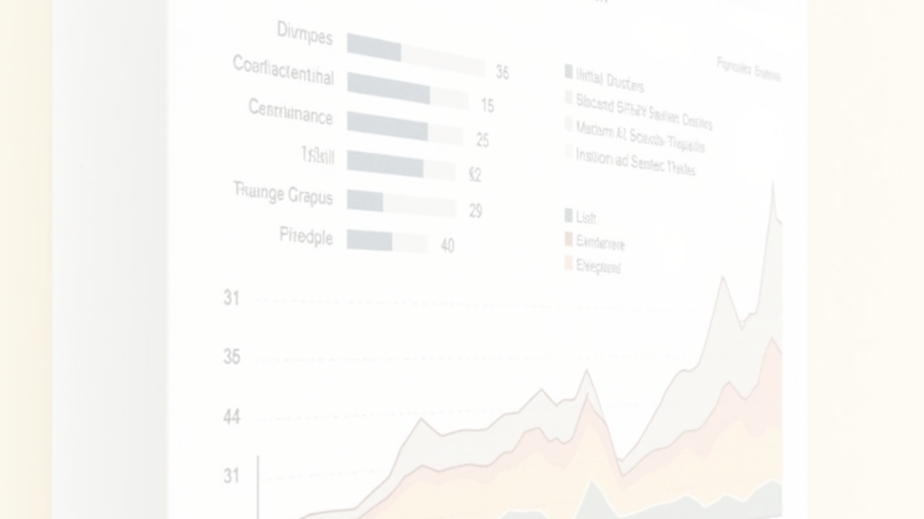

Normalization and Visualization
1
Normalization
Expands abbreviations (e.g., “ML” → “Machine Learning”).
2
Visualization
Plotly charts for skill distribution, confidence, and extraction methods.

Slide 12
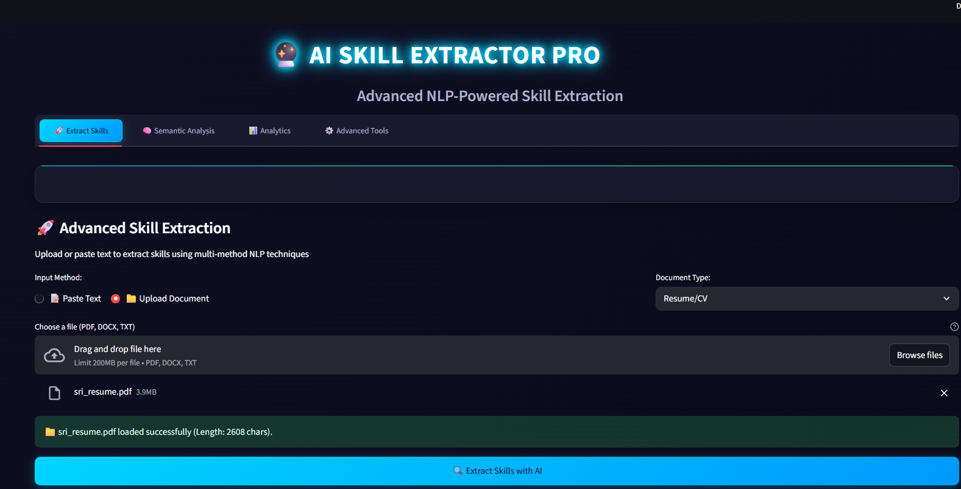
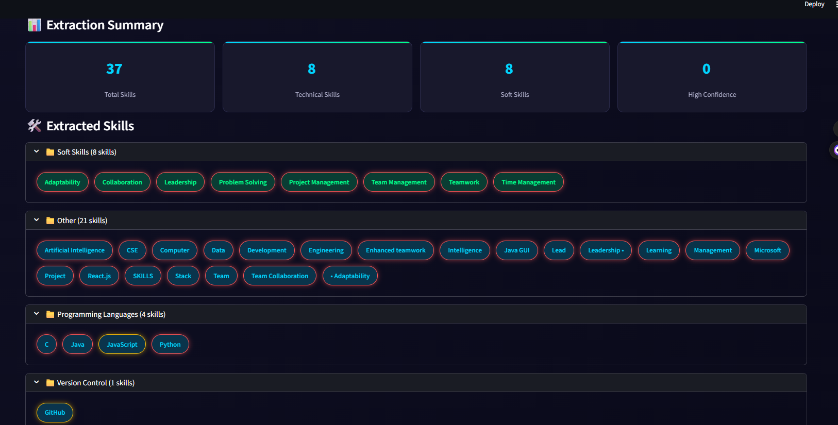

Slide 13
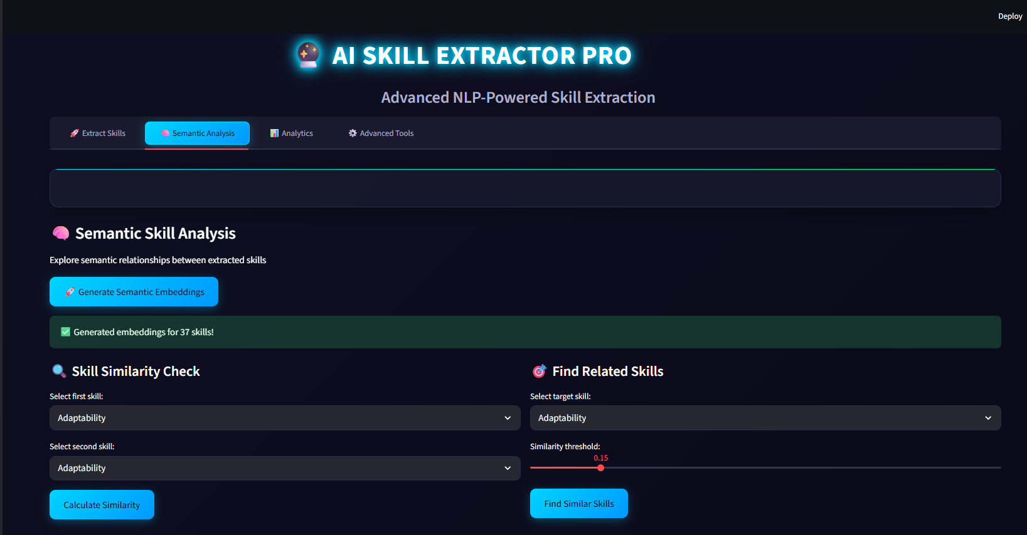
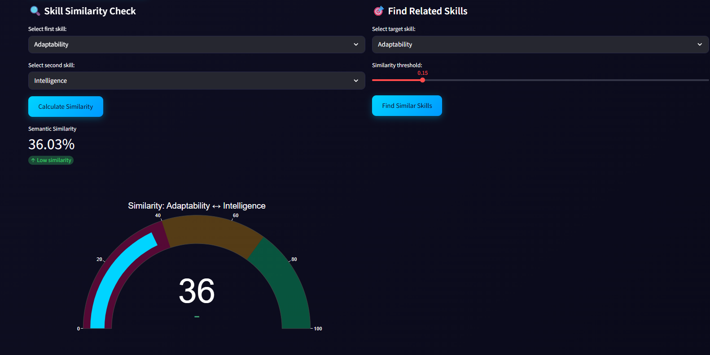

Slide 14
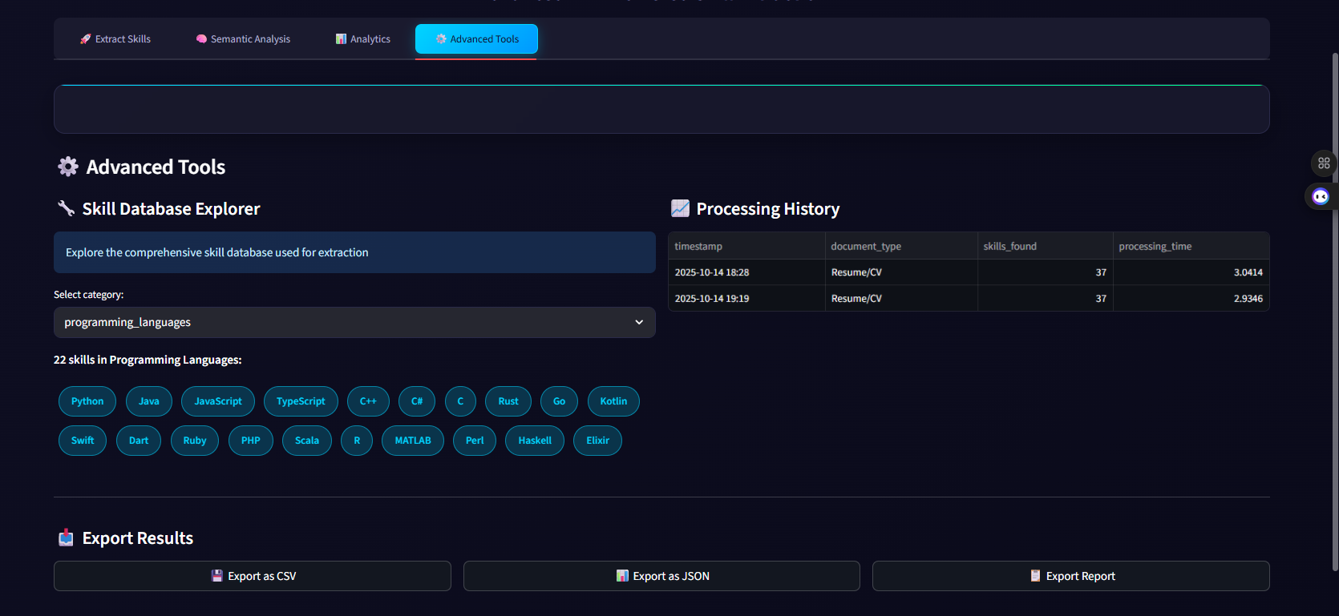
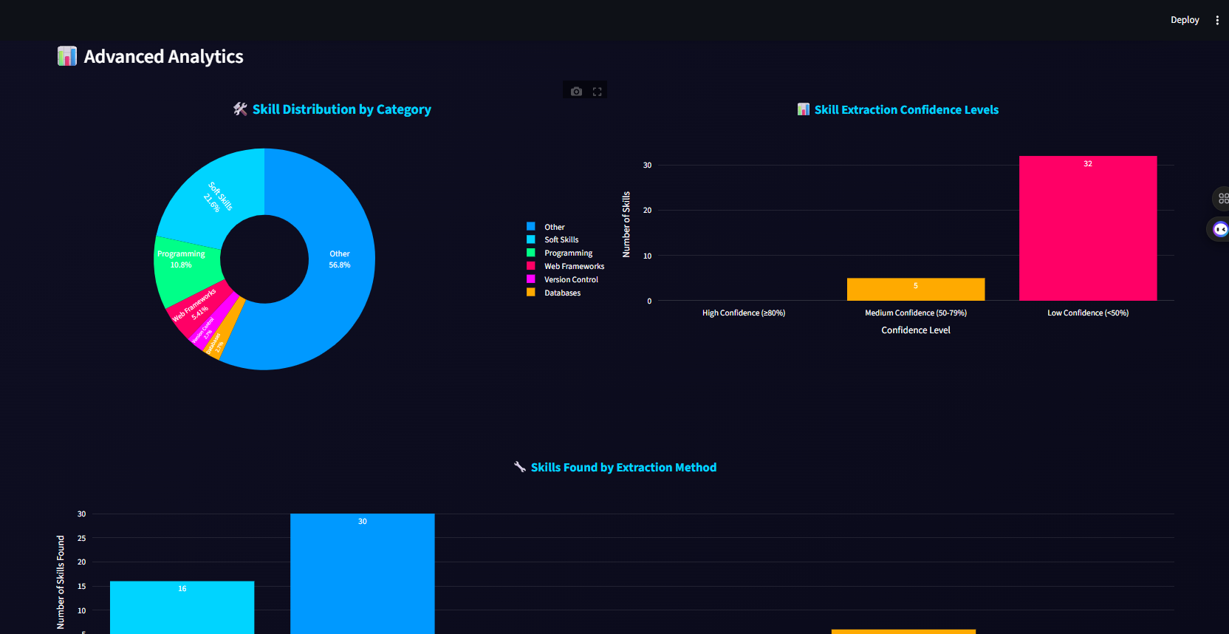

Slide 15





Challenges
1
Handling noisy text from diverse document formats.
2
Balancing accuracy and performance in semantic embeddings.
3
Ensuring robust confidence scoring across methods.

Slide 16




Security
Temporary file handling ensures no residual data (deleted after processing).
No sensitive data is stored; processing is done in-memory.
Streamlit’s secure session state for user data.

Slide 17


Scalability
1
Modular design allows easy addition of new extraction methods or skills.
2
Caching in SentenceBERTEmbedder reduces redundant computations.
3
Supports batch processing of multiple documents (future scope).

Slide 18

Conclusion
Summary
• Developed a robust NLP-powered skill extractor with multi-method extraction.
• Supports diverse inputs (text, PDF, DOCX, TXT) with M1 file readers.
• Provides semantic analysis and rich visualizations.

Slide 19

Thank You

